Slide 1
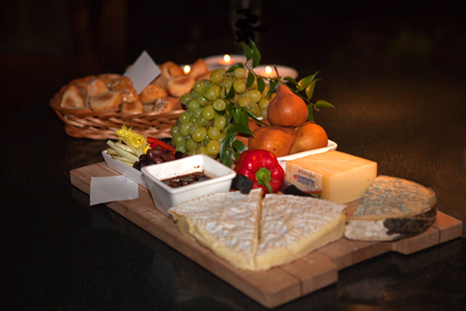
MACROMOLECULES

Slide 2
Announcements
Lab Wednesday – Extra Credit: bring in a food to test: MUST BE DRY and cannot not contain nuts

Slide 3
Macromolecules
4 Types:
Carbohydrates
Lipids
Proteins
Nucleic Acids
** All are large molecules created by joining together small ones **

Slide 4
How do we measure energy from food?
4 MACROMOLECULES | Number of calories it provides
Carbohydrates
Proteins
Lipids
Nucleic Acids
Energy gained by consuming food = calorie

Slide 5
Carbohydrates
** Also called saccharides **
Carbon, Hydrogen, Oxygen 1 C : 2 H : 1 O = ratio
Roles: energy, digestion, absorption, eliminates toxins/waste
3 types:
Monosaccharide
Disaccharide
Polysaccharide

Slide 6
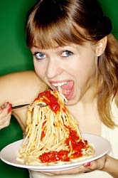
Energy Gained From Carbohydrates
Eating 1 gram of carbohydrates provides your body with 4 Calories.

Slide 7
1. Monosaccharides
“Simple Sugars”
Example: Glucose
Sources: Fruit, Cookies, Candy, Honey
Sweet taste & give IMMEDIATE energy

Slide 8
2. Disaccharides
2 monosaccharides linked together
Examples: sucrose (table sugar), lactose (milk), maltose (starch)
Sweet taste & quick source of energy

Slide 9
3. Polysaccharides
Long carbohydrate chains
“Complex Carbohydrates”
Digestion takes longer & sustained use of energy
Examples: Amylose (starch), Glycogen, Cellulose
Sources: bread, pasta, oatmeal, rice, broccoli, kidney beans, chick peas

